Slide 1
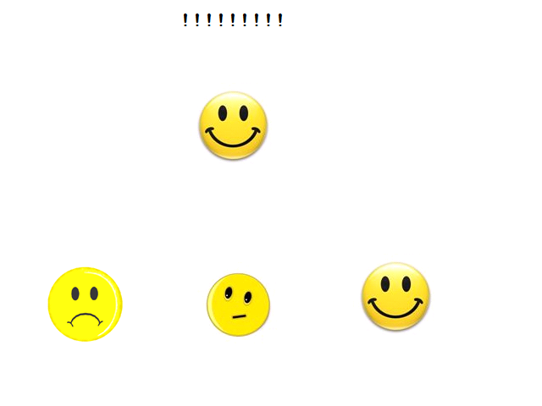
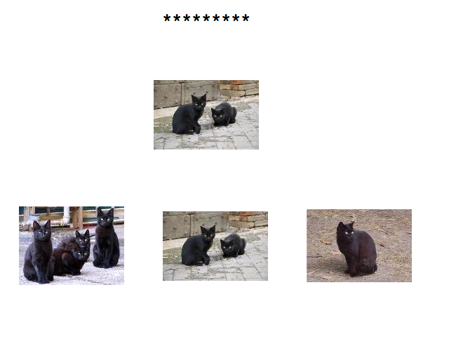
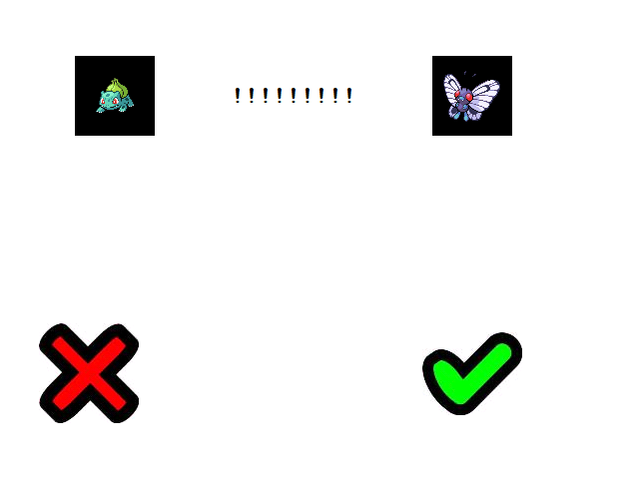
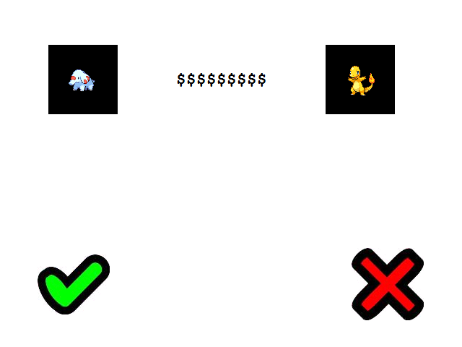
Procedural adaptations for a relational training to improve IQ scores in young children Rabelo, Laura Z.; Faccioli, Juliana S.; de Rose, Julio C. laurazrabelo@gmail.com Universidade Federal de São Carlos (UFSCar) Brazil
Studies have shown that performance on relational tasks has been directly correlated with IQ scores (Gore, Barnes-Holmes & Murphy, 2010; O´Hora, Pelaez & Barnes-Holmes, 2005; O´Hora, Pelaez, Barnes-Holmes, Rae, Robinson & Chaudhary, 2008; O’Toole & Barnes-Holmes, 2009). Cassidy, Roche & Hayes (2011) obtained an increase in IQ scores of 12 year old children following a relational training procedure. The aim of this study was to replicate the procedure of Cassidy, Roche and Hayes (2011) with younger participants and extend the analyses of results, investigating the impact of a relational training on analogical reasoning.
Participants
24 six to eight-year-old children who attend a public school (half of them in experimental and the other half in control condition).
Setting and materials
Data collection takes place in the participants’ school.
- Wechsler Intelligence Scale for Children - WISC-III (Raven, Raven, & Court, 1988) and Raven’s Colored Progressive Matrices (WISC-III - Wechsler, 2002);
Drawings and pictures of familiar objects that could represent SIMILARITY, OPPOSITION, MORE THAN and LESS THAN were used for establishing contextual cues;
Pokemons were used as stimuli for the multiple exemplar training of arbitrary relations;
A laptop equipped with E-Prime software (Schneider, Eschman, & Zuccolotto, 2002; Schneider, Eschman, & Zuccolotto, 2007).
PowerPoint presentations were used to give instructions to participants.
Procedure
The participants performed experimental sessions five times a week in a room provided by their school.
No participant has finished the procedure so far. Additional conditions were required in order to prevent repetition of sessions and mistakes:
- Establishment of contextual cue: blocked sessions, an intraverbal protocol (the experimenter asked the participant to describe the stimuli on the screen) and, in one case, physical help. Moreover, in order to prevent an abrupt interruption of feedback, it was progressively decreased in sessions before the test.
- Multiple Exemplar Training: errorless trials were programmed.
Since data collection is still in progress, other additional conditions may be necessary. Barnes-Holmes, Barnes-Holmes and Smeets (2004a) effectively taught arbitrary relations of OPPOSITE TO and Barnes-Holmes, Barnes-Holmes, Smeets, Strand and Friman (2004b) taught MORE THAN and LESS THAN relations to preschoolers with a tabletop procedure, what raises the question if computerized sessions are the most appropriate tool for establishing relational repertoires in young children.
Barnes-Holmes, Y., Barnes-Holmes, D., Smeets, P. M., Strand, P., & Friman, P. (2004). Establishing relational responding in accordance with more-than and less-than as generalized operant behavior in young children. International Journal of Psychology and Psychological Therapy, 4(3), 531-558.
Barnes-Holmes, Y., Barnes-Holmes, D., & Smeets, P. M. (2004). Establishing relational responding in accordance with opposite as generalized operant behavior in young children. International Journal of Psychology and Psychological Therapy, 4(3), 559-586.
Cassidy, S., Roche, B., & Hayes, S. C. (2011). A relational frame intervention to raise intelligence quotients: a pilot study. The Psychological Record, 61, 173-198.
Gore, N. J., Barnes-Holmes, Y., & Murphy, G. (2010). The relationship between intellectual functioning and relational perspective-taking. International Journal of Psychology and Psychological Therapy, 10, 1-17.
O´Hora, D., Pelaez, M., & Barnes-Holmes, D. (2005). Derived relational responding and performance on verbal subtests of the WAIS-III. The Psychological Record, 55, 155-175.
O´Hora, D., Pelaez, M., Barnes-Holmes, D., Rae, G., Robinson, K., & Chaudhary, T. (2008). Temporal relations and intelligence: correlating relational performance with performance on the WAIS-III. The Psychological Record, 58, 569-584.
O’Toole, C., & Barnes-Holmes, D. (2009). Three chronometric indices of relational responding as predictors of performance on a brief intelligence test: the importance of relational flexibility. The Psychological Record, 59, 119-132.
Raven, J. C., Raven, J. & Court, J. H. (1988). Matrizes Progressivas Coloridas de Raven. Manual. São Paulo: Casa do Psicólogo.
Schneider, W., Eschman, A., & Zuccolotto, A. (2002). E-Prime user’s guide. Pittsburgh: Psychology Software Tools Inc.
Schneider, W., Eschman, A., & Zuccolotto, A. (2007). E-Prime® (Version 2.0) [Computer software]. Pittsburgh, PA: Psychology Software Tools Inc.
Wechsler, D. (2002). WISC-III: Escala de Inteligência Wechsler para Crianças: Manual. 3ª edição; São Paulo: Casa do Psicólogo.
RESULTS
Experimental sequence | More information
1. Initial intelligence and analogical reasoning assessment | WISC-III and Raven’s Colored Progressive Matrices application
2. Contextual cue training and testing | SIMILARITY and OPPOSITION
3. Multiple Exemplar Training of arbitrary relations | SIMILARITY and OPPOSITION
4. Derived relations test | SIMILARITY and OPPOSITION
5. Contextual cue training and testing | MORE THAN and LESS THAN
6. Multiple Exemplar Training of arbitrary relations | MORE THAN and LESS THAN
7. Derived relations test | MORE THAN and LESS THAN
8. Final intelligence and analogical reasoning assessment | WISC-III and Raven’s Colored Progressive Matrices application
PRELIMINARY DISCUSSION
METHOD
REFERENCES
Example of a contextual cue trial for SIMILARITY
Example of a contextual cue trial for LESS THAN
Example of a MET trial of arbitrary relations of OPPOSITION
Example of a MET trial of arbitrary relations of MORE THAN

